Slide 1

All Party Group on Ageing and Older People
29th March, 2023

Slide 2
Where we are now...
Priority Themes | Agreed Actions
NI Network Steering Group | Two year action plan to be developed
Resourcing of Age Sector Networks | Thematic subgroup to be developed
Transport | Thematic subgroup to be developed
Communication and Information | Thematic subgroup to be developed
Age Friendly Design Principles | Thematic subgroup to be developed

Slide 3












Where we would like to be in …
Additional priority themes developed with thematic
sub-groups and associated targets. i.e Housing, Employment
Age-Friendly implemented at all levels including Central Government, Local Government and third sector.

Slide 4
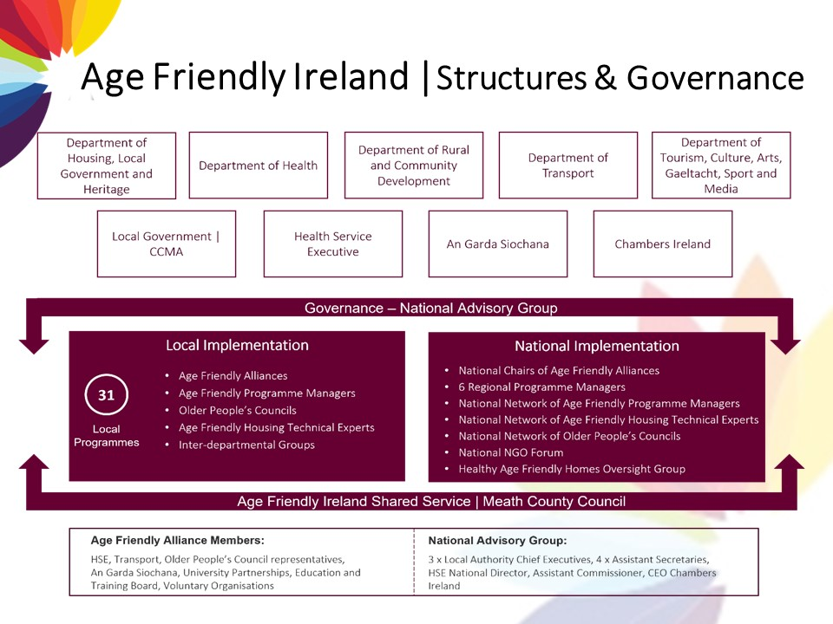

Slide 5
How do we get there…
Age Friendly Network NI
11 Local Council Areas
Age Sector Networks
/Age NI
Effective resourcing of Age-Sector Networks
Continued support and resourcing of Age-Friendly
Programmes in 11 Council areas across NI
Resourcing and support of Age-Friendly Network NI
How could APG support this vision?
Support to secure funding for two staff members to support and drive delivery of proposed Age-Friendly Network NI action plan
Advocate for Age-Friendly at all levels in Central Government support

Slide 6
Questions…

