Slide 1

Preventing and Managing Frailty in Older People
NI Frailty Network Update
All Party Group for Older People
Monday 22nd May 2023
Alison Patterson, Frailty Programme Manager, Public Health Agency
Dr Jan Ritchie, Consultant Geriatrician. Co-chair NI Frailty network
Notes:
Hello
Thankyou
Having to read from screen on left…apologies
Introduce
A little bit about frailty and why it is important
The role of the frailty network
Impact of COVID on our older people

Slide 2
Overview
What is Frailty and what does it look like
Demographics
Role of the NI Frailty Network
National links
Example of work in care homes

Slide 3

Frailty Syndromes
Falls
Continence issues
Poly Pharmacy (more than 5 medications)
Mild Cognitive disorder
Immobility
Social Isolation and Loneliness
Nutrition
Notes:
Adults aged 65+ with some of the syndromes above are likely to be living with frailty
Groups with a high frailty prevalence:
Living in care homes
Dementia
65+ with 4 + long term conditions
10+ medications
Complex medical conditions, at end of life
Housebound
Known to community nursing / social care services
Aged 85+

Slide 4
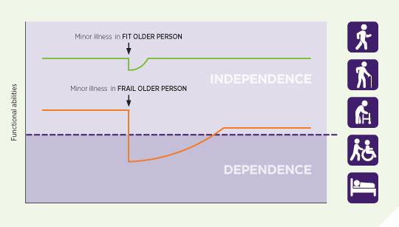
Impact of Frailty on Independence
British Geriatrics Society

Slide 5
NI Population Trends 1971 - 2021
Year | Total | 0-14 years | 15-39 years | 40-64 years | 65+ years | % Aged 65+
1971 | 1,536,065 | 456,997 | 512,242 | 400,842 | 165,984 | 10.80%
1981 | 1,481,959 | 384,306 | 547,147 | 372,367 | 178,139 | 12.00%
1991 | 1,577,836 | 385,275 | 588,712 | 404,797 | 199,052 | 12.60%
2001 | 1,685,267 | 370,952 | 610,446 | 480,544 | 223,325 | 13.30%
2011 | 1,810,863 | 354,703 | 618,452 | 573,988 | 263,720 | 14.60%
2021 | 1,903,100 | 365,200 | 594,300 | 617,100 | 326,500 | 17.20%
Points to Note:
Younger (0-14) population falling (decreasing birth rates)
40-64 age population has increased by over 50% between 1971 – 2021 - need to plan for this growth moving into the 65+ age bands
65+ population has doubled between 1971 – 2021 – increased life expectancy

Slide 6
Prevalence of Frailty
Source: NISRA (2021 Population Mid Year Estimates, 2033 Projections are 2020 based
More than one in ten people over 65 years in the community live with frailty.
Frailty also affects over half of adults in hospital or care home settings.
Frailty is increasing as people are living longer with multiple long-term conditions.
The number of people in the UK over the age of 85 is set to double by 2045, with up to half of this age group living with Frailty.
Notes:
Conservative estimate, based on UK
Pre-COVID19

Slide 7
Positives:
Frailty is preventable
Frailty is reversible
Can prevent further deterioration
Increase independence
Improve quality of life / experience
Improve value for money
Notes:
Like many conditions, the biggest impact in terms of potential to reverse or improve is at the earliest opportunity
Even if there is no potential for reversal, eg where frailty level is severe, it is always possible to deliver better outcomes – eg preferred place of care, end of life care,

Slide 8
Our Work
Identification – Everybody’s business
Education
Benchmarking Audits – 2018/19, 2022/23, 2023/24
Prevention/Public Health Messaging
Health Economist
Falls Pathway for Care Homes – Enhanced Clinical Care Framework for Care Homes

Slide 9
National links
Strong links with British Geriatrics society, Irish Gerontological society
BGS is the membership association for professionals specialising in the healthcare of older people across the UK. There are over 4,500 members and are the only society in the UK offering specialist expertise in the wide range of healthcare needs of older people
Recent system challenges including:
  Social care crisis
  Elective care backlog
  Fuel poverty and food insecurity
  Facilities that aren’t designed for older people with dementia or a physical disability
  IT/information governance arrangements across providers
  Workforce…..workforce….workforce
    17 consultant vacancies at present, predicted to increase to 37 in 5 years
    11 only out of possible 20 trainees in post
    In London: 1 geriatrician per 3700 over 65y and 1 per 487 over 85y

Slide 10
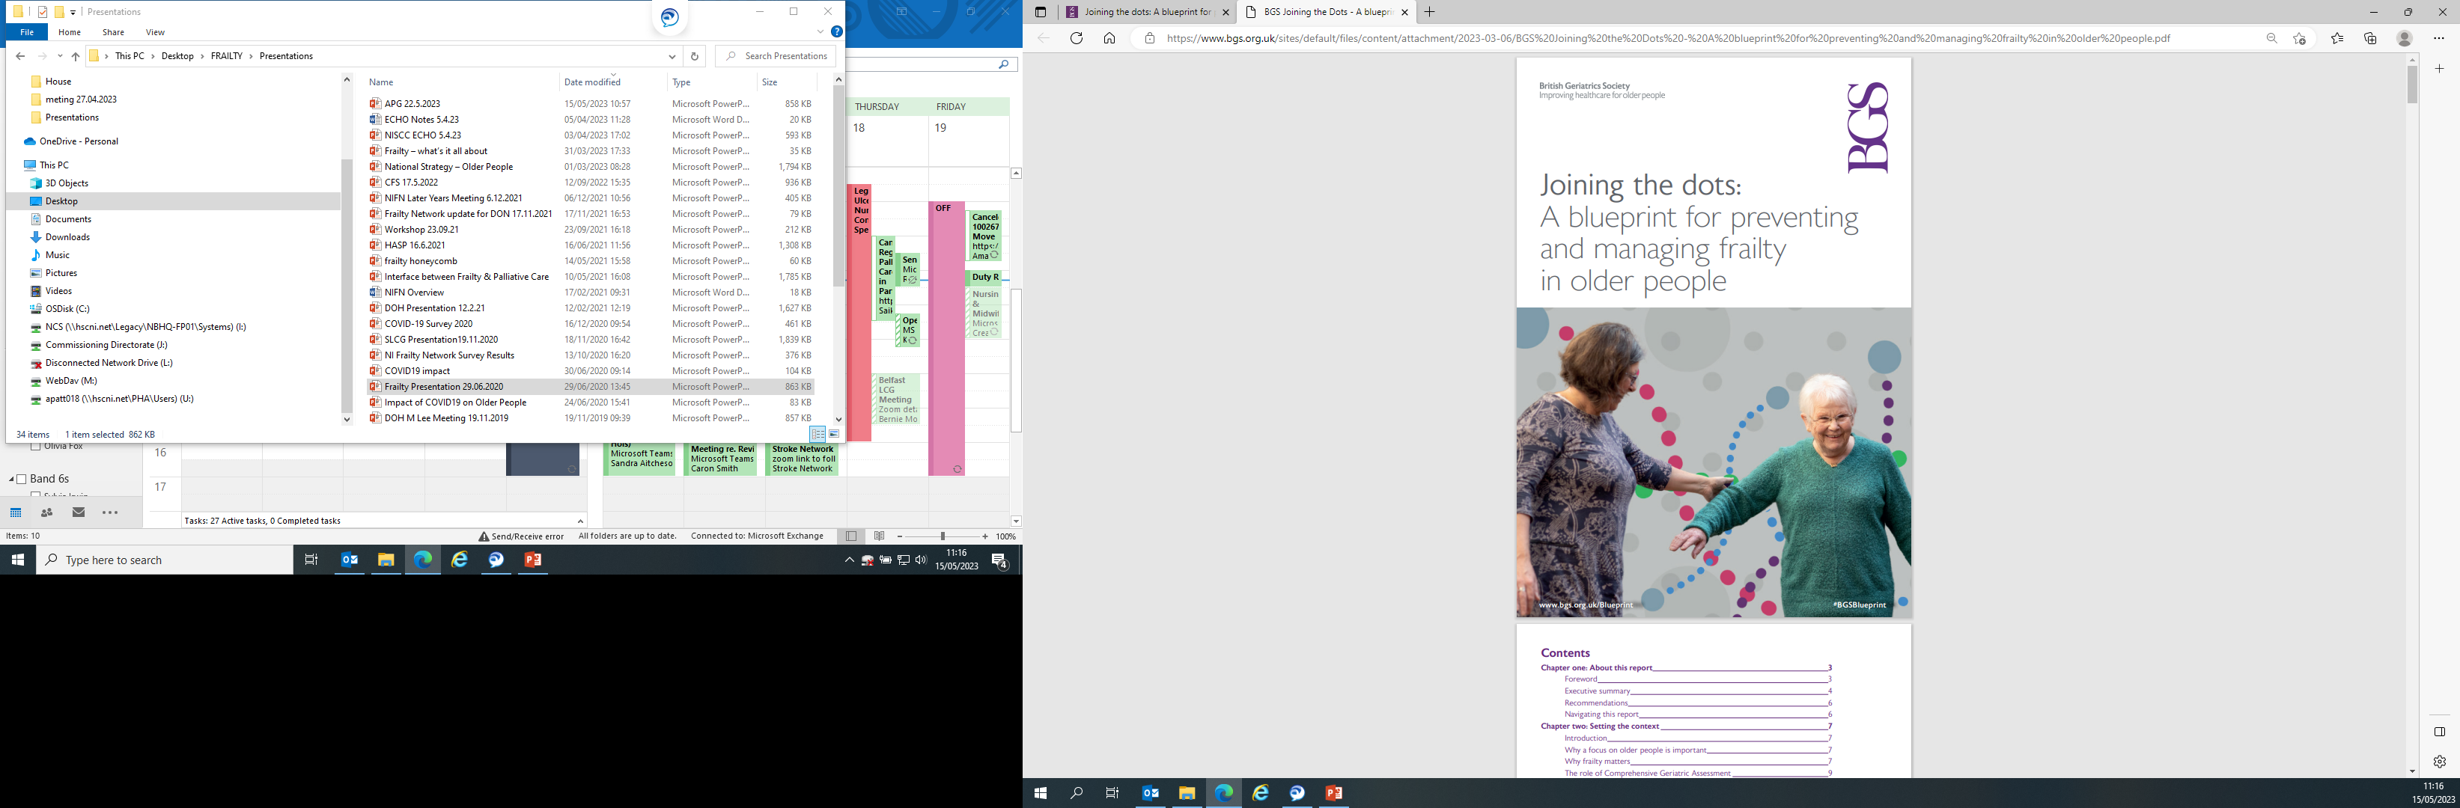
BGS Blueprint for preventing and managing frailty in older people
Developed by Anne Hendry and working group from across UK
Designed to support system leaders and commissioners
Ensure that voice of older people is heard and represented in care planning and delivery
Important that older people’s health and care are considered as its own entity and not part of general adult services
If services work for older people, they are more likely to work for the rest of the population
Notes:
Studies to find out the impact of COVID:
Talk to older people
Age NI Check in and Chat – Feedback
Age Friendly Communities
Engage with Age – Big Day Inside and Out - Forum
NI Frailty Network – planned survey of members – impact on older people as seen by older people and others involved in delivering care to older people
Other Research:
Inst. Public Health Ireland – Survey on coping with Loneliness, Isolation and COVID19
Kings College London - PROTECT study – looking specifically at impact of self isolation on older adults
NHS England – The Aftercare Needs of Inpatient Recovering from COVID19
NHS Reset - points to the need for rehab for those who have been self isolating

Slide 11
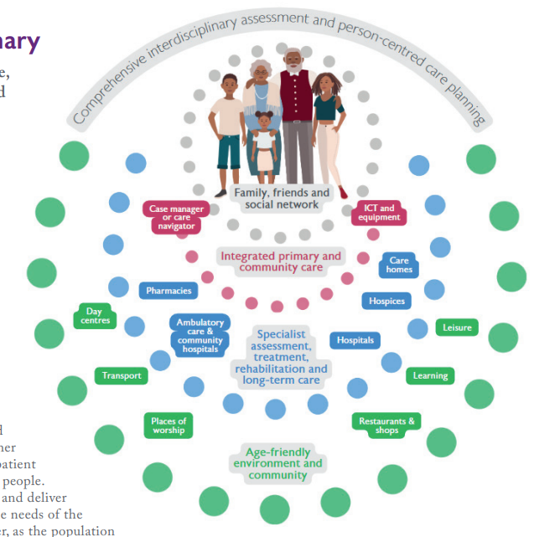

Slide 12
Core recommendations
Recommendation 1: Demonstrate strong system leadership that creates a shared vision for healthy ageing and preventing and managing frailty.
Recommendation 2: Appoint a senior officer or nonexecutive Board member with a specific role to seek ongoing assurance on the quality of health and social care for older people and their carers.
Recommendation 3: Publish baseline, then annual, State of Ageing reports on system-wide outcome indicators related to care for older people including feedback from patients and carers to reflect their experience
Recommendation 4: Develop a system-wide strategy and costed implementation plan for a population health approach to the prevention and management of frailty, including a specific focus on dementia and falls.

Slide 13
Recommendation 5: Commission or deliver inter-professional education that is aligned with the Skills for Health frailty core capabilities framework and builds capacity for comprehensive geriatric assessment, quality improvement and integrated practice in all disciplines across the system.
Recommendation 6: Develop an integrated Workforce Plan to build adequate specialist and generalist multidisciplinary capacity and skill mix to care for older people with complex needs.
Recommendation 7: Protect and preserve the right to rehabilitation for all older people who need it, in line with the principles outlined by the Community Rehabilitation Alliance.
Recommendation 8: Publish an older people equality and diversity impact assessment and action plan.

Slide 14
Recommendation 9: Engage and involve older people, carers and communities as equal partners with health and social care professionals in co-design, delivery and monitoring the impact of these services and support.
Recommendation 10: Provide support to enable the lived experience of older people and carers, including those with dementia and mobility, sensory or communication needs, to inform ongoing quality improvement and assurance.
Recommendation 11: Work with public health, housing, community and voluntary sector partners to build social capital, mobilise community assets and adopt place-based approaches to create inclusive, compassionate age- and dementia-friendly communities

Slide 15
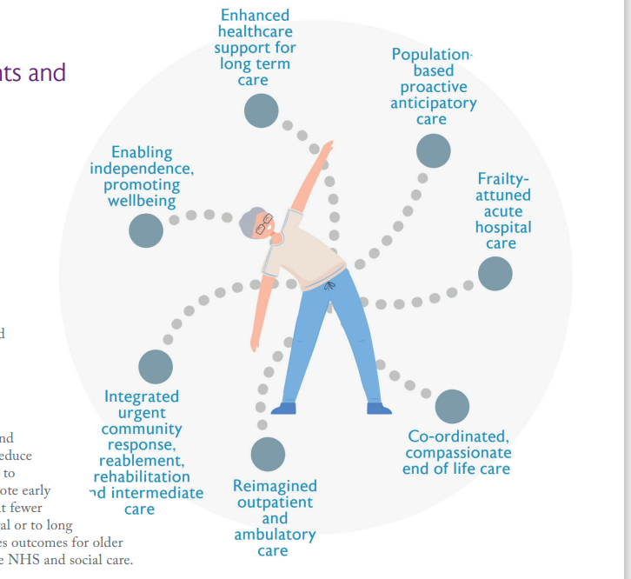
System Touchpoints
Not a pathway
People may dip in and out at various points and stages of their life and illness
Wrap around services when needed
Focus on prevention and maintaining health and wellbeing
Focus on care delivered in the community including care homes
Holistic and multidisciplinary care
Strong emphasis on rehabilitation services and maintaining independence

Slide 16



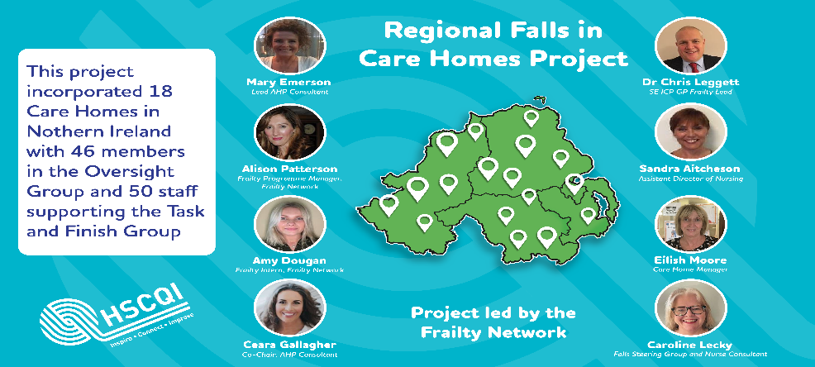
CARE HOMES
Regional Falls in Care Homes Pathway
When the post falls management guideline and falls checklist and review document were utilised, results indicate an increase in people living and working in Care Homes feeling confident about safer mobility.
Aim
Involvement
Change ideas
To improve resident experience and quality of life to 80% and reduce risk of falls by 30% in 18 care homes in NI by March 2023;
Why-Falls are significant issue in NI for our whole HSC system and ultimately for the residents QOL
Collective NI leadership across complex system. Key stakeholder codesign and involvement across 18 NI Partner Care Homes (nursing and residential) service users and families,HCPs, ALBs, Primary , Emergency and secondary care, statutory and Independent sectors.
Codesigned a Regional falls Pathway and Bundle
Safer Mobility
Management of falls
Learning from Falls
The project was led by the Frailty Network delivering to ECCF
Measure
• 97% of residents no longer felt afraid of falling
• 82% of residents reported that they knew how to move safely to reduce the risk of falls
• 82% of residents reported that they felt safe and confident moving around the home
• 93% of residents said they had all the equipment to help them move more safely
• 91% of residents felt less worried about tripping and falling
• 50% of staff felt confident in promoting safer mobility in their residents at the start of testing, this increased to 82% post testing
• 68% of staff felt confidence in managing a resident fall at the start of testing, this increased to 82% post testing.
Photo of team/project location/change idea
Next steps
Phase 3 of the Falls in Care Homes Project-Using technology, communication and meaningful activity.
Falls in care homes eLearning with CEC
Write up of ECCF FFA with key recommendations May 2023
Sustainability and spread workplan

Slide 17
Contact:
Alison Patterson
Alison.Patterson@hscni.net
Join the NI Frailty Network at:
Frailtynetwork@hscni.net
https://frailtynetwork.hscni.net

